Slide 1
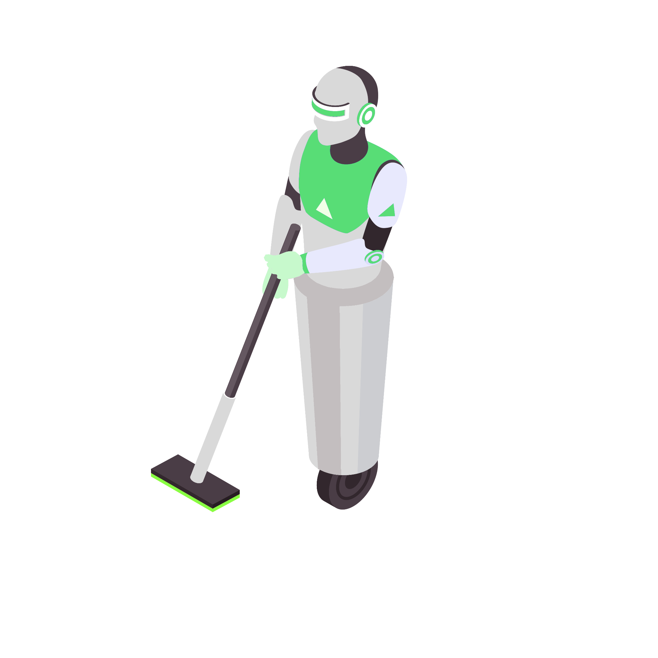

FLOOR CLEANING ROBOT WITH ANDROID BASED VOICE COMMAND
TEAM MEMBERS:
MIDHUN V S (953620106046)
PONDURAI M (953620106054)
GUIDED BY:
Dr. S Vairaprakash
Associate Professor
Department of ECE

Slide 2
ABSTRACT
The Voice-Controlled Floor Cleaning Robot with Android Application Integration introduces a novel solution for household cleaning tasks. Leveraging voice command technology and mobile connectivity, the work aims to transform floor cleaning in modern homes. Users can remotely control the robot via a dedicated Android application, eliminating manual intervention and saving time. Voice commands issued through the app are transmitted to the robot's microcontroller, enabling seamless execution of predefined functions. Equipped with sensors and navigation systems, the robot autonomously navigates, avoids obstacles, and optimizes cleaning patterns. This cutting-edge integration of voice command and mobile technology offers a streamlined and efficient solution for floor cleaning, setting new standards for smart home cleaning systems and enhancing user convenience and efficiency.

Slide 3
INTRODUCTION
This paper introduces a Voice-Controlled Floor Cleaning Robot with Android Application Integration, aiming to revolutionize floor cleaning by leveraging voice commands and mobile connectivity. The robot autonomously performs cleaning tasks and responds to voice commands issued through a dedicated Android app, enhancing user experience and remote accessibility. It incorporates sweeping and mopping functions for various floor surfaces, promising efficiency and adaptability. By integrating sensors and navigation systems, the robot ensures efficient movement and obstacle avoidance, promising both cleanliness and adaptability to different home environments. This work represents a significant stride towards creating smart homes where automation and user-friendly interfaces converge. The subsequent sections of this paper will delve into the technical aspects and design considerations of this innovative Voice-Controlled Floor-Cleaning robot with Android Application Integration.

Slide 4
LITERATURE SURVEY
Arduino Based Voice Controlled Robot
In this paper, the Voice Controlled Robot (VCR) utilizes voice commands received through a microphone, processed by a voice module, and transmitted via Zigbee to an ATmega2560 development board. Servo motors execute actions based on recognized commands. The robot features a camera for live transmission and recording. The speech recognition circuit operates independently, preserving the main CPU's processing power.

Slide 5
Floor Cleaning Robot (Autonomous/ Manual)
In this paper, A floor cleaning robot was designed for autonomous and manual cleaning using a mobile application that was connected to Bluetooth of the robot's microcontroller. The movement input was given by the buttons that were pressed in the mobile application. When the forward button is pressed then the information is shared using Bluetooth technology to the microcontroller of the robot. According to the input, the floor cleaning robot works. For autonomous mode, there is a switch in the robot, which should be turned on manually.

Slide 6
OBSERVATION AND MOTIVATION FROM SURVEY
From the literature survey it is observed that the existing method consist of some drawbacks, such as
The bluetooth model used in the robot to get voice command can be only used in the distance of 0-10 meter.
Obstacle in its path is not detected so the robot may crash in the obstacle.
The commands are given to the robot frequently to clean a place, which is very uncomfortable for the user.
The house cleaning robot offers efficiency by automating floor cleaning, saving users time and effort. Voice command integration adds convenience, enabling remote control from smartphones. It's accessible to users with disabilities and versatile, cleaning various floor surfaces.

Slide 7
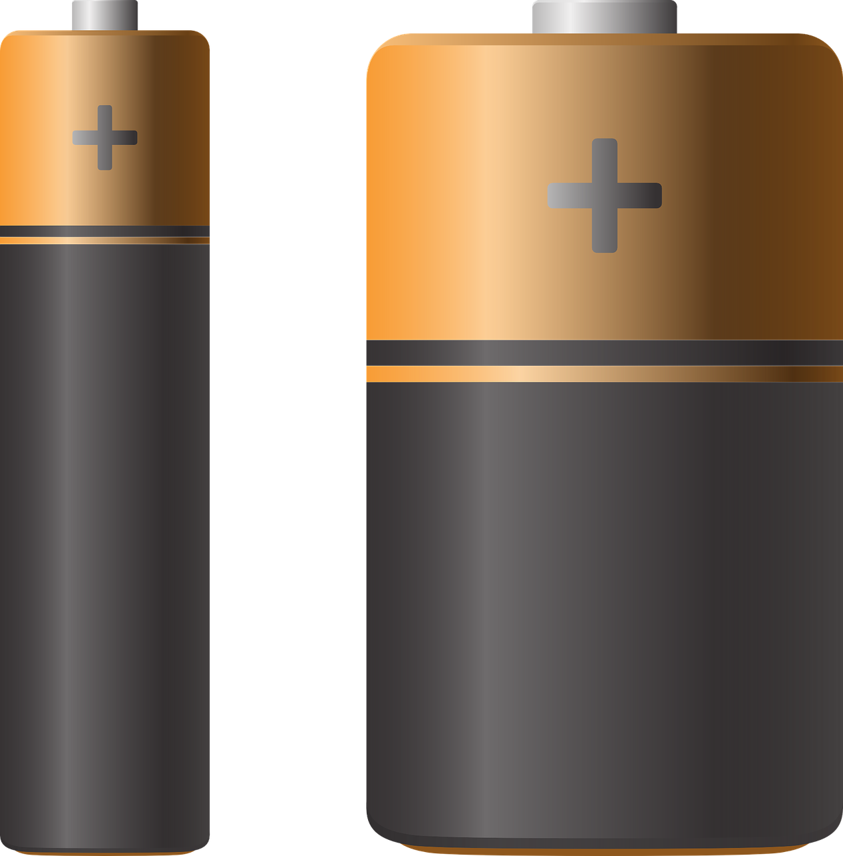


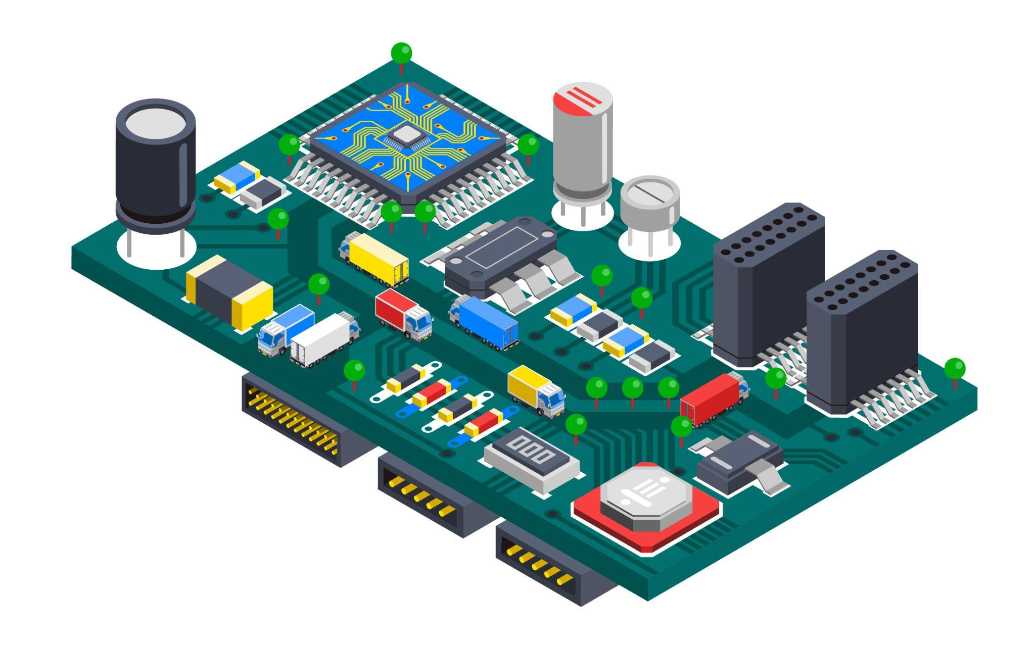

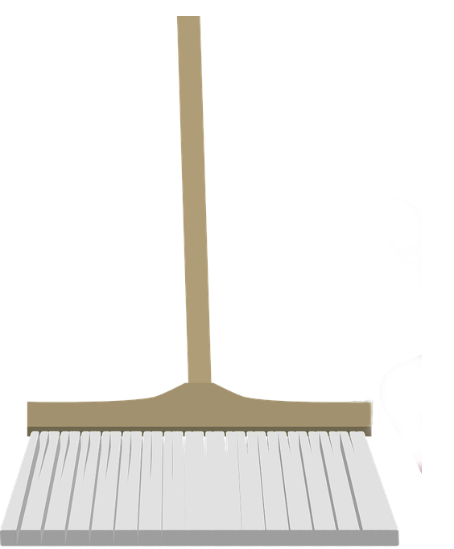

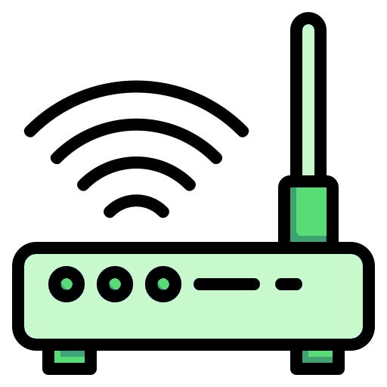
METHODOLOGY
Internet
Power Source
Android App
ThingSpeak IOT
Microcontroller (ESP8266)
Movement & Clean
Voice Command
WiFi (Internet)

Slide 8
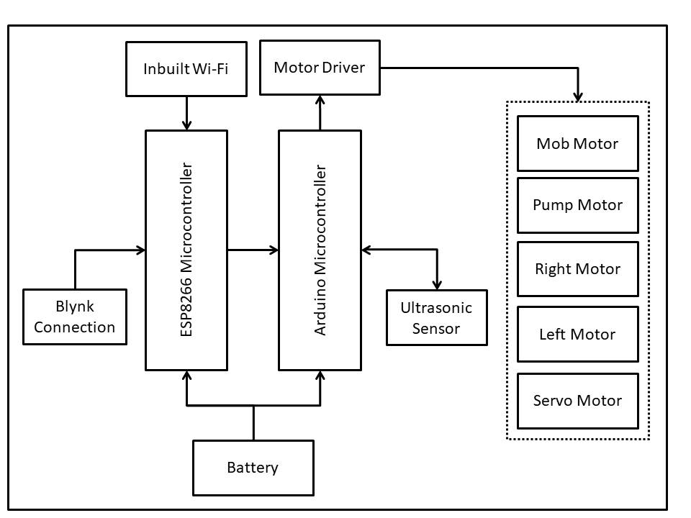
BLOCK DIAGRAM
ThingSpeak Connection

Slide 9
DESIGN COMPONENTS
ESP32 Microcontroller
1
4
Sensors
ThingSpeak IOT
2
5
Motors
Arduino Microcontroller
3
6
Battery

Slide 10
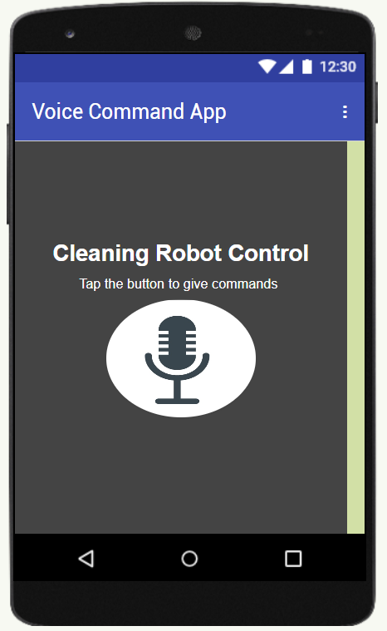
ANDROID APPLICATION
The application features a single image button, depicting a microphone symbol, which serves as the gateway for users to interact with the robot using their voice. Upon pressing the microphone button within the application, the device's microphone is activated, allowing users to speak commands directly into their smartphone or tablet. The application leverages advanced speech recognition technology to transcribe the user's voice accurately commands into text format. Once the speech recognition process is completed, the text-based commands are securely transmitted to a cloud-based server for further processing.

Slide 11
THE TASK’S
Input (Application) | Output (Robot)
Forward | Moves Forward
Backward | Moves Backward
Turn Right | Turns Right
Turn Left | Turns Left
Automatic | Autonomous Cleaning
Stop / Finish | Stops the current Task
Cleaning | Rotates the Mob & Spray’s Water

Slide 12
RESULTS AND DISCUSSIONS
The autonomous floor-cleaning robot efficiently reduces cleaning time, benefiting working mothers by alleviating physical labor. Its ability to autonomously clean various surfaces enhances versatility, achieving objectives of efficiency and convenience. The Android application features a microphone symbol for voice interaction, utilizing advanced speech recognition technology to transmit commands securely to a cloud-based server. This approach ensures rapid response times and scalability for future enhancements. Overall, the robot and its Android-based voice command application offer a user-friendly interface, enhancing cleaning efficiency and convenience in modern households.

Slide 13
VIDEO DEMONSTRATION
https://youtu.be/IET9qNXmBq0

Slide 14
LINKS
ESP8266 CODING: https://docs.google.com/document/d/1P5irf7IkumdlmQAAMo1GMKJp0hmHvvWv/edit
ARDUINO CODING:
https://docs.google.com/document/d/1jXQUUMfcrVPMDh8Mz380-gpQhwGUgLbP/edit
APPLICATION LINK:
https://drive.google.com/file/d/1Ice-UyVwo2VSUuJgf-7w1gDutuiMpGuj/view
SIMULATION LINK:
https://wokwi.com/projects/377675979438608385

Slide 15
APPLICATIONS
Residential Cleaning: The robot can be used in households for daily floor cleaning tasks, reducing the manual effort required for maintaining cleanliness.
Commercial Spaces: Offices, hotels, and other commercial establishments can deploy the robot to automate floor cleaning routines, ensuring cleanliness throughout the day.
Hospitals and Healthcare Facilities: In healthcare settings where hygiene is crucial, the robot can aid in keeping floors clean without the need for constant human intervention.
Educational Institutions: Schools, colleges, and universities can benefit from deploying the robot to maintain cleanliness in classrooms, corridors, and other common areas.
Smart Homes: The robot can be integrated into smart home ecosystems, allowing users to control cleaning activities using voice commands via their smartphones or smart speakers.

Slide 16
MERITS
Time for cleaning the floor can be reduced
This project will reduce the physical work of the person.
Until the robot is turn off, they can repeat the same task continuously.
The Robot can clean different surface like tiles, hardwoods etc.

Slide 17
DEMERITS
Robot can only do what they are told to do – they can’t improvise.
The robot may run out of charge in the middle of a cleaning session.
The cleaning robot can’t clean stairs.
Moderate cleaning quality

Slide 18
REFERENCES
ARDUINO BASED VOICE CONTROLLED ROBOT by K. Kannan, Dr. J. Selvakumar PG Scholar, Embedded System Technology, SRM University, Tamil Nadu, India AP (S.G), ECE Department, SRM University, Tamil Nadu, India,International Research Journal of Engineering and Technology 2015.
Floor Cleaning Robot (Autonomous/ Manual), Vatsal N Shah, Sathvik K P V S, Indus University, Ahmedabad, India, International Journal of Engineering Research & Technology (IJERT) ISSN: 2278-018 1NCIMACEMT - 2016 Conference Proceedings.
Implementation Of Goods Lifter Robots With Android Based Voices Orders, Hidyatullah, Jhonson Efendi Hutagalung, Royal Kisaran, Study Programm Of Computer Technic, Kisaran Indonesia, IOP Conf. Series: Journal of Physics: Conf. Series 1255 (2019).
Design and implementation of a cost effective vacuum cleaner robot by Anıl Eren, Hatice Doğan, Dokuz Eylul University, Engineering Faculty, Electrical and Electronics Engineering Department, Izmir, Turkey, Turkish Journal of Engineering – 2022

Slide 19
Robot Voice A Voice Controlled Robot using Arduino, Vineeth Teeda, K.Sujatha, Rakesh Mutukuru, International Journal of Engineering and Advanced Technology (IJEAT) August 2016.
Floor cleaning robot with reconfigurable mechanism, Veerajagadheswar Prabakarana, Mohan Rajesh Elaraa, Thejus Pathmakumara, Shunsuke Nansaib, Engineering Product Development, Singapore University of Technology and Design, Automation in Construction 91 (2018).
Arduino Based Voice Controlled Robot, Aditya Chaudhry, Manas Batr, Prakhar Gupta, Information Technology, Bharati Vidyapeeth’s College Of Engineering, New Delhi, 2019 International Conference on Computing, Communication, and Intelligent Systems.
A Study on Precise Control of Autonomous Driving Robot by Voice Recognition, Sung-Won Jung1, Ki-Won Sung 1, Moon-Youl Park1, Department of Advanced Engineering, kyungnam University, Changwon, 631-701, Korea

Slide 20
THANK YOU

